Slide 1

Green Pace
Security Policy Presentation
Developer: Anthony Apuzzo

Slide 2

OVERVIEW: DEFENSE IN DEPTH
Policy defining Defense in Depth utilizing:
Standard
Procedure
Guidelines
Notes:
Policy: A policy indicates management intent, in support of the principle. (Beddoe, 2015)
Standard: A set of mandatory rules in support of the policy. (Beddoe, 2015)
Procedure: A checklist or step-by-step instructions for implementing policies and standards (Beddoe, 2015)
Guidelines: Best practices and recommendations and should usually be considered (Beddoe, 2015)

Slide 3
THREATS MATRIX
Likely High Priority INT30-C – Ensure that unsigned integer operations do not wrap MEM51-CPP – Properly deallocated dynamically allocated resources STR50-CPP – Guarantee that storage for strings has sufficient space for character data and the null terminator | Probable High Priority STD-001-CPP – SQL injection
Probable ERR51-CPP – Handle all exceptions STR52-CPP – Use valid references, pointers, and iterators to reference elements of a basic string | Unlikely DCL58-CPP – Do not modify the standard namespaces FI051-CPP - Close files when they are no longer needed MSC11-C – Incorporate diagnostic tests using assertions STR53-CPP – Range Check element access
Notes:
INT30-C - One must not allow integers to wrap due a possible vulnerability in exposing memory that a user should not have access to.
STR52-CPP - If one were to use an invalid reference, pointer, or iterator it will result in undefined behavior.
STR53-CPP - The std::string index operators const_reference operator[](size_type) const and reference operator[](size_type) return the character stored at the specified position, pos. When pos >= size(), a reference to an object of type charT with value charT() is returned. The index operators are unchecked (no exceptions are thrown for range errors), and attempting to modify the resulting out-of-range object results in undefined behavior.
STD-001-CPP - If you do not sanitize your parameters you can allow malicious SQL code to enter in places that could breach your system.
MEM51-CPP - Deallocating a pointer that is not allocated dynamically (including non-dynamic pointers returned from calls to placement new()) is undefined behavior because the pointer value was not obtained by an allocation function. Deallocating a pointer that has already been passed to a deallocation function is undefined behavior because the pointer value no longer points to memory that has been dynamically allocated.
MSC11-C - When it is executed, if expression (which must have a scalar type) is false, the assert macro outputs information about the failed assertion (including the text of the argument, the name of the source file, the source line number, and the name of the enclosing function) on the standard error stream, in an implementation-defined format, and calls the abort() function.
ERR51-CPP - When an exception is thrown, control is transferred to the nearest handler with a type that matches the type of the exception thrown.
DCL58-CPP - Namespaces introduce new declarative regions for declarations, reducing the likelihood of conflicting identifiers with other declarative regions
FI051-CPP - A call to the std::basic_filebuf<T>::open() function must be matched with a call to std::basic_filebuf<T>::close() before the lifetime of the last pointer that stores the return value of the call has ended or before normal program termination, whichever occurs first.
STR50-CPP - Copying data to a buffer that is not large enough to hold that data results in a buffer overflow. Buffer overflows occur frequently when manipulating strings [Seacord 2013]. To prevent such errors, either limit copies through truncation or, preferably, ensure that the destination is of sufficient size to hold the data to be copied. C-style strings require a null character to indicate the end of the string, while the C++ std::basic_string template requires no such character.

Slide 4
10 PRINCIPLES
Validate Input Data: INT30-C, STR52-CPP, STD-001-CPP
Heed Compiler Warnings: MEM51-CPP, STR50-CPP
Architect and Design for Security Policies
Keep it simple: STR52-CPP, DCL58-CPP, FIO51-CPP
Default Deny
Adhere to the principle of Least Privilege: STD-001-CPP
Sanitize Data Sent to Other Systems
Practice Defense in Depth: MSC11-CPP
Use Effective Quality Assurance Techniques: STR52-CPP, MEM51-CPP, ERR51-CPP
Adopt a Secure Coding standard: MSC11-CPP, ERR51-CPP, DCL58-CPP, FIO51-CPP

Slide 5
CODING STANDARDS
MEM51-CPP – Properly deallocated dynamically allocated resources
STR50-CPP – Guarantee that storage for strings has sufficient space for character data and the null terminator
STD-001-CPP – SQL injection
INT30-C – Ensure that unsigned integer operations do not wrap
STR52-CPP – Use valid references, pointers, and iterators to reference elements of a basic string
STR53-CPP – Range Check element access
DCL58-CPP – Do not modify the standard namespaces
ERR51-CPP – Handle all exceptions
FI051-CPP - Close files when they are no longer needed
MSC11-C – Incorporate diagnostic tests using assertions
Notes:
(severity, likelihood, remediation cost)
MEM51-CPP – Properly deallocated dynamically allocated resources(high, likely, medium)
STR50-CPP – Guarantee that storage for strings has sufficient space for character data and the null terminator (high, likely, medium)
STD-001-CPP – SQL injection (high, probable, medium)
INT30-C – Ensure that unsigned integer operations do not wrap (high, likely, high)
STR52-CPP – Use valid references, pointers, and iterators to reference elements of a basic string (high, probable, high)
STR53-CPP – Range Check element access(high, unlikely, medium)
DCL58-CPP – Do not modify the standard namespaces (high, unlikely, medium)
ERR51-CPP – Handle all exceptions (low, probable, medium)
FI051-CPP - Close files when they are no longer needed(medium, unlikely, medium)
MSC11-C – Incorporate diagnostic tests using assertions(low, unlikely, high)

Slide 6
ENCRYPTION POLICIES
Encryption in rest – when data is not in use
Encryption at flight – when data is moving between systems
Encryption in use – when data is actively being used
Notes:
Encryption at rest is designed to prevent the attacker from accessing the unencrypted data by ensuring the data is encrypted when on disk. If an attacker obtains a hard drive with encrypted data but not the encryption keys, the attacker must defeat the encryption to read the data (Azure Data 2022). This ties in with our security policy by how we need to think defense in depth. We must take into consideration that even though some data is not being used in the moment it should be encrypted and well protected. We can also look at this from a perspective of the principle of least privilege to prevent unneeded access.
Encryption in flight is encrypting data that is moving between systems such as servers (Encryption for data-in-transit 2022). We will need to consider when moving data between any of our systems that is properly secured in case it were to be intercepted. This will follow along the Sanitize Data Sent to Other Systems standard to make sure we do this correctly by sending data through secure channels as well.
Encryption in use is to protect data that may be in use by the user such as account details. We would want to utilizing hashing to protect and verify the password. This will add another defense layer and will incorporate when they are stored in a database somewhere else and hit that inflight moment as well.

Slide 7
TRIPLE-A POLICIES
Authentication – verifying a user is who they say they are
Authorization – users have correct access based on predetermined rules
Accounting – logging what a user does while in the system
Notes:
Authentication - This would be the first step of authenticating the user via the login info they provide. This allows you a first layer of security that makes sure proper authorization to an access is granted (Mylonas, 2018). Authentication is apart of the policy because it allows us to control who the person attempting to access the system is. For instance, security principles Default Deny (5) and Adhere to the Principle of Least Privilege (6) show how maintain who access our systems is a fundamental in maintaining a secure system.
Authorization - Authenticating correctly and then storing the passwords salted with no process for decrypting, while allowing for resetting of passwords but never retrieval (Mylonas, 2018). Authorization follows up on authentication in that we want to make if someone is authenticated and can access they are only given access to what they need, based on this authorization. This authorization process is something we do not want to do in any sort of open-source file so encrypting appropriately keeps us in sync with adhering to secure coding standards.
Accounting - This mean to keep track what a user did. These can be what resources were accessed, at what time, by who, and what commands were issued (Mylonas, 2018). This allows audits of the system to see did what in case of any bad actors. It is important to remember that security does not stop once a system hits production, in a way, it has just begun. A major part of the DevSecOps cycle is monitoring the network to check for intrusions, but it is as equally as important to monitor what happens right in front of you in case something goes wrong internally.

Slide 8
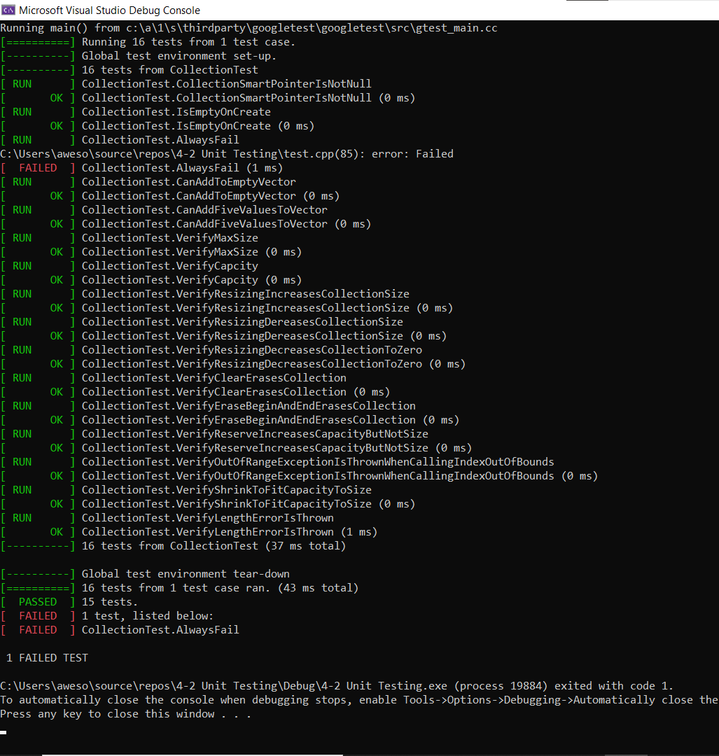
Unit Testing
Notes:
Collection pointer is not null
Test that a collection pointer is not null
Is empty on create
Test that a collection is empty when created.
Can add to empty vector
verify adding a single value to an empty collection
Can add five values to sector
verify adding five values to collection
Verify max size
verify that max size is greater than or equal to size for 0, 1, 5, 10 entries
Verify capacity
verify that capacity is greater than or equal to size for 0, 1, 5, 10 entries
Verify resizing increases collection size
verify resizing increases the collection
Verify resizing decreases collection size
verify resizing decreases the collection
Verify clear erases collection
verify clear erases the collection
Verify erase begin and end erases collection
verify erase(begin,end) erases the collection
Verify reserve increases capacity but not size
verify reserve increases the capacity but not the size of the collection
Verify out of range exception is thrown when calling index out of bounds
Negative test verify the std::out_of_range exception is thrown when calling at() with an index out of bounds
Verify shrink to fit capacity to size
Negative test verify can lower capacity to meet size of list
Verify length error is thrown
testing if reserving more then max size throws length error

Slide 9
Unit Testing Options
Google test framework (http://google.github.io/googletest/)
CppuTest
(https://github.com/cpputest/cpputest)
Notes:
http://google.github.io/googletest/
testing and mocking
can start a project in visual studio with this pre built in it
https://github.com/cpputest/cpputest
testing and mocking

Slide 10

AUTOMATION SUMMARY
Notes:
Assess and plan
Design
Build
Verify and test
Transition and health check
Monitor and detect
Respond
Maintain and stabilize

Slide 11
TOOLS
DevSecOps pipeline is an ongoing security effort from beginning to the never ending support of the application
Two stages - Pre Production and Production
Unit testing tools during design
Scanning tools during verify and test
Notes:
Pre production
Assess and plan
Design
Build
Verify and test
Production
Transition and health check
Monitor and detect
Respond
Maintain and stabilize

Slide 12
RISKS AND BENEFITS
Problems to avoid:
Crashing software
Data leaks
Solutions to try:
Defensive coding (TDD, policy guidelines to gauge priority)
Don’t stop monitoring (log everything, AAA)
Risks
Longer deployment time
Higher cost
Benefits
Secure system
Consumer trust

Slide 13
RECOMMENDATIONS
The policy is up to date as of 10/16/2022
Stay on top of everchanging guidelines
Do not stop following policy after release
Update software regularly to maintain secure releases
Policy will not cover entire application, add to as needed
Notes:
Ongoing effort for successful DevSecOps cycle. Does not end after production occurs, last as long as a product is in use

Slide 14
CONCLUSIONS
[Identify standards that should be adopted to prevent future problems.]
Understanding threats against your system
Types of hackers
Types of attacks
Educate and train new users (Synopsis Team, 2020)
Notes:
-Type of actors: white hat, black hat, state actors, script kiddies, hacktivists
-Types of attacks: sql injection, penetration testing, DDoS attacks
-
-Educating and training new users allows the security plan to continue to be respected and utilized as it should be.
Employee training should be a part of your organization’s security DNA. Having a well-organized and well-maintained security training curriculum for your employees will go a long way in protecting your data and assets. Include awareness training for all employees and secure coding training for developers. Do it regularly, not just once a year. And conduct simulations like phishing tests to help employees spot and shut down social engineering attacks (Synopsis Team, 2020)
.

Slide 15
REFERENCES
Azure Data Encryption-at-rest - azure security. Azure Data Encryption-at-Rest - Azure Security | Microsoft Learn. (2022, August 18). Retrieved from https://learn.microsoft.com/en-us/azure/security/fundamentals/encryption-atrest
Beddoe, W. (2015, October 2). Understanding the hierarchy of principles, policies, standards, procedures, and guidelines. LinkedIn. Retrieved from https://www.linkedin.com/pulse/understanding-hierarchy-principles-policies-standards-wally-beddoe/
Notes:
Azure Data Encryption-at-rest - azure security. Azure Data Encryption-at-Rest - Azure Security | Microsoft Learn. (2022, August 18). Retrieved from https://learn.microsoft.com/en-us/azure/security/fundamentals/encryption-atrest
Encryption for data-in-transit - microsoft service assurance. Microsoft Service Assurance | Microsoft Learn. (2022, September 22). Retrieved from https://learn.microsoft.com/en-us/compliance/assurance/assurance-encryption-in-transit

Slide 16
REFERENCES
Encryption for data-in-transit - microsoft service assurance. Microsoft Service Assurance | Microsoft Learn. (2022, September 22). Retrieved from https://learn.microsoft.com/en-us/compliance/assurance/assurance-encryption-in-transit
Mylonas, L. (2018, November 27). What is AAA Security? an introduction to authentication, Authorisation and Accounting. Codebots. Retrieved from https://codebots.com/application-security/aaa-security-an-introduction-to-authentication-authorisation-accounting

Slide 17
REFERENCES
Synopsis Team. (2020, June 29). Are you following the top 10 software security best practices? Application Security Blog. Retrieved from https://www.synopsys.com/blogs/software-security/top-10-software-security-best-practices/

